Slide 1

ECE 478-578 Intelligent Robotics I
PhD. Husnu Melih Erdogan – Electrical & Computer Engineering
herdogan@pdx.edu Teaching Assistant – Lab Assistant

Slide 2
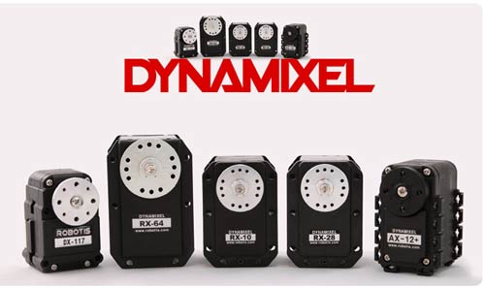
Dynamixel

Slide 3
How to Setup Dynamixel Servos

Slide 4
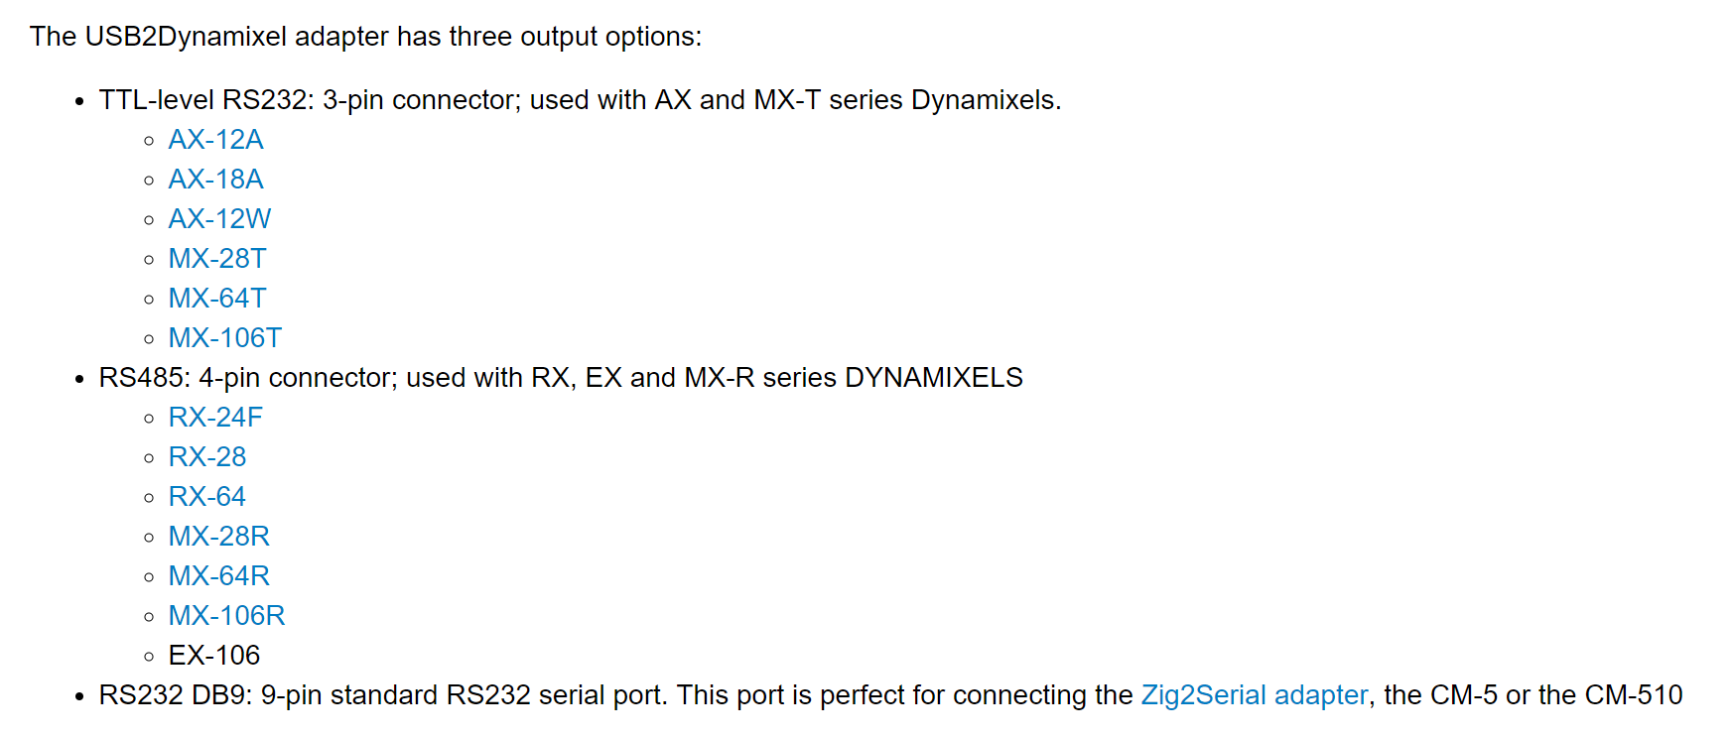
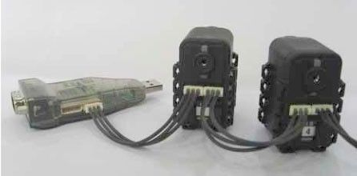
USB2Dyanmixel Adaptor

Slide 5
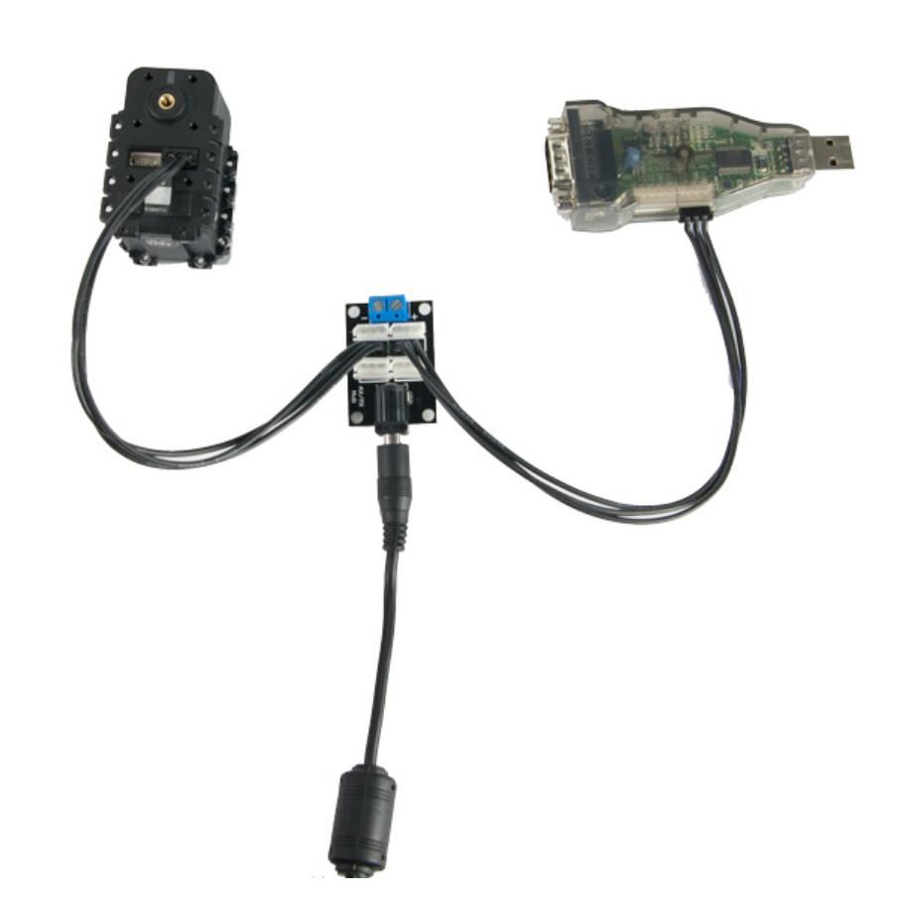
Power Hub

Slide 6
Dyanmixel Servos
Dynamixel actuators have been used by every major university, research lab, military & government research lab, and robotic competition worldwide.
The casing of each servo is built specifically with robotics in mind, providing easy to use mounting rails and a comprehensive bracket system available for building robotic limbs.
TTL and RS-485 serial communication allows for daisy-chainable bus connections at up to 1-3mbps.

Slide 7
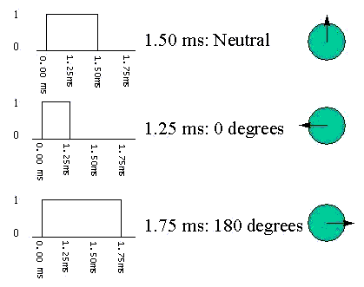
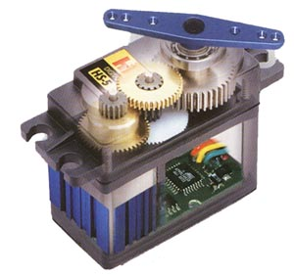
How Regular Servos Work
http://www.pyroelectro.com/tutorials/servo_motor/servomotor.html
http://www.pitt.edu/~sorc/robotics/handbook/ServoControl.htm
Conventional Servo motors are used for positioning
every 20ms you need to send a pulse to the servo motor,
the width of this pulse determines the position the servo.
This has to be done for every servo motor in the system => large overhead on main mcu.

Slide 8
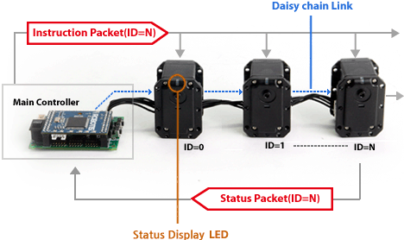
How Dynamixel Servos Work
Dynamixels are driven by digital packet communication. The main communication protocol is half-duplex UART (8-bit, no parity, 1 stop).
It supports TTL, RS485, or CAN networks. Dynamixel communicates with the main controller by sending and receiving packets of data on a bus.
Dynamixels are ‘networked’:
each Dynamixel in the chain must have a unique ID
they are connected via a Daisy Chain, and
255 Dynamixels can be connected to each network.
http://tribotix.com/Products/Robotis/Dynamixel/DynamixelIntro.htm
Use serial communication:
TTL serial (3 wire) or RS485 (4 wire), and
1Mbps to 3Mbps communication speeds.

Slide 9
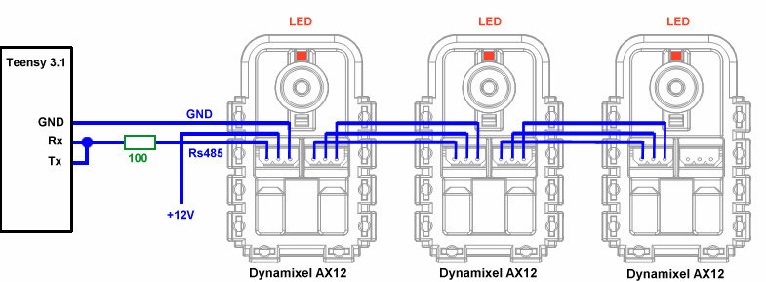
Basic Setup for Controlling Dynamixel Servos

Slide 10
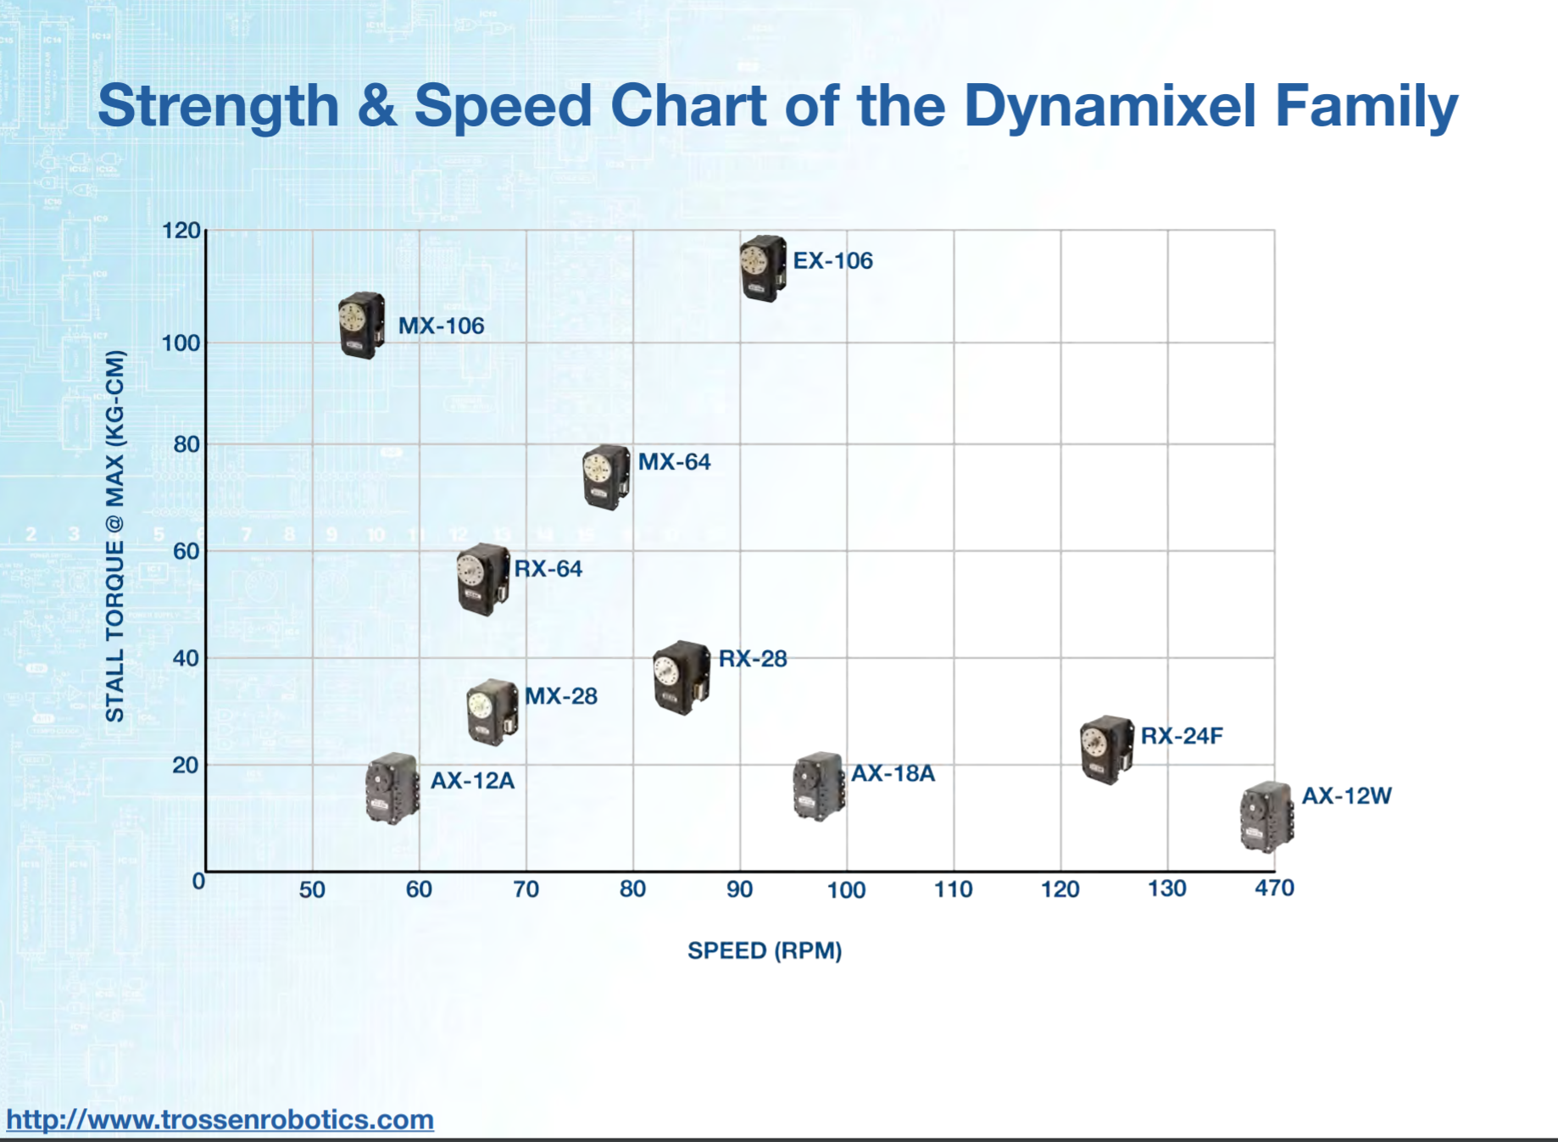
Dynamixel Servo Family

Slide 11
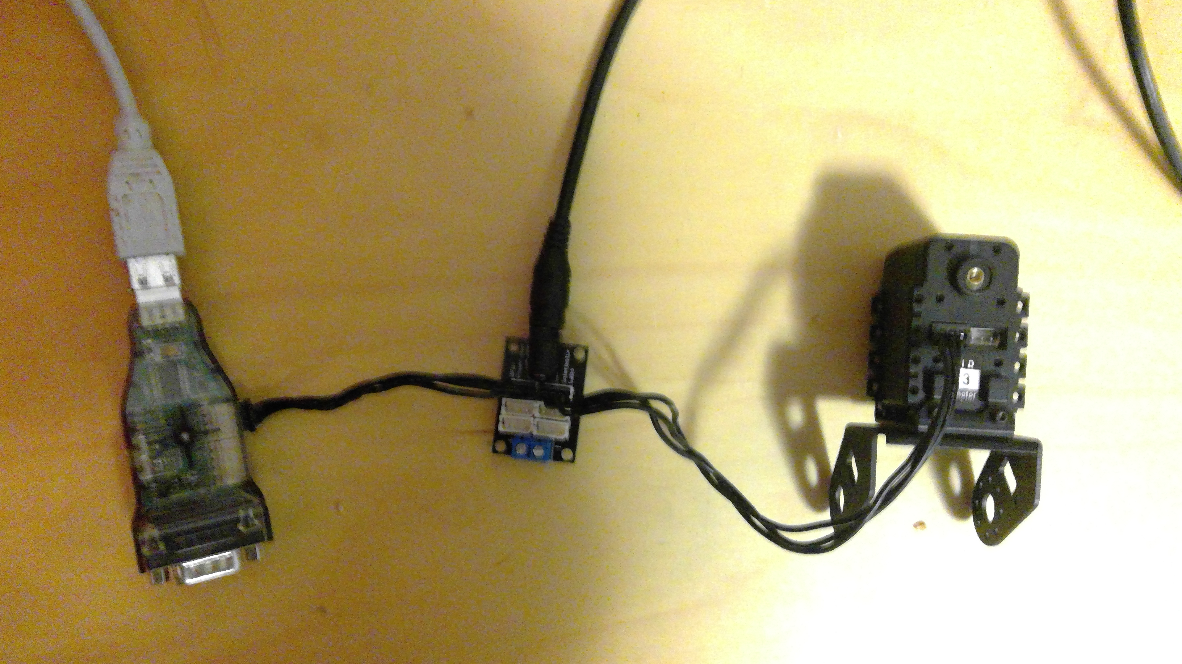
Servo Test/Control Setup
USB Cable Connected to a USB HUB that is connected to a PC.
Dynamixel AX12
12V DC
USB2Dynamixel
- Make sure the switch on the side is at TTL.

Slide 12
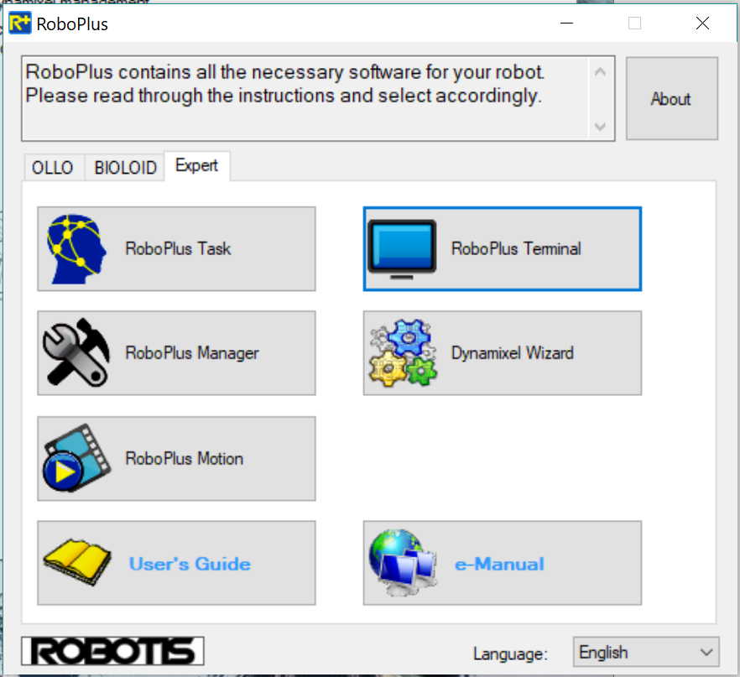
RoboPlus
You need to install RoboPlus
We will use the tool called Dynamixel Wizard.

Slide 13
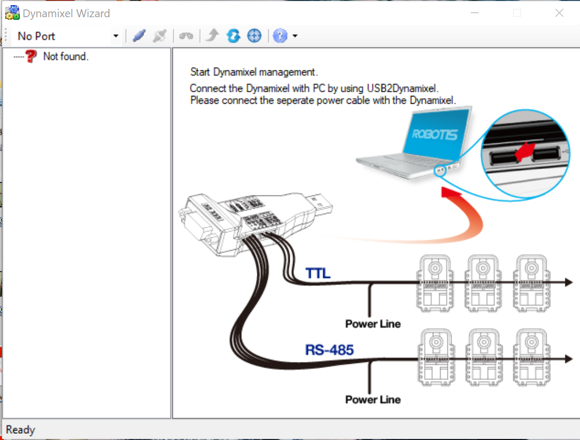
Dynamixel Wizard – Open a port
Click on open port button to establish a connection
Select the port

Slide 14
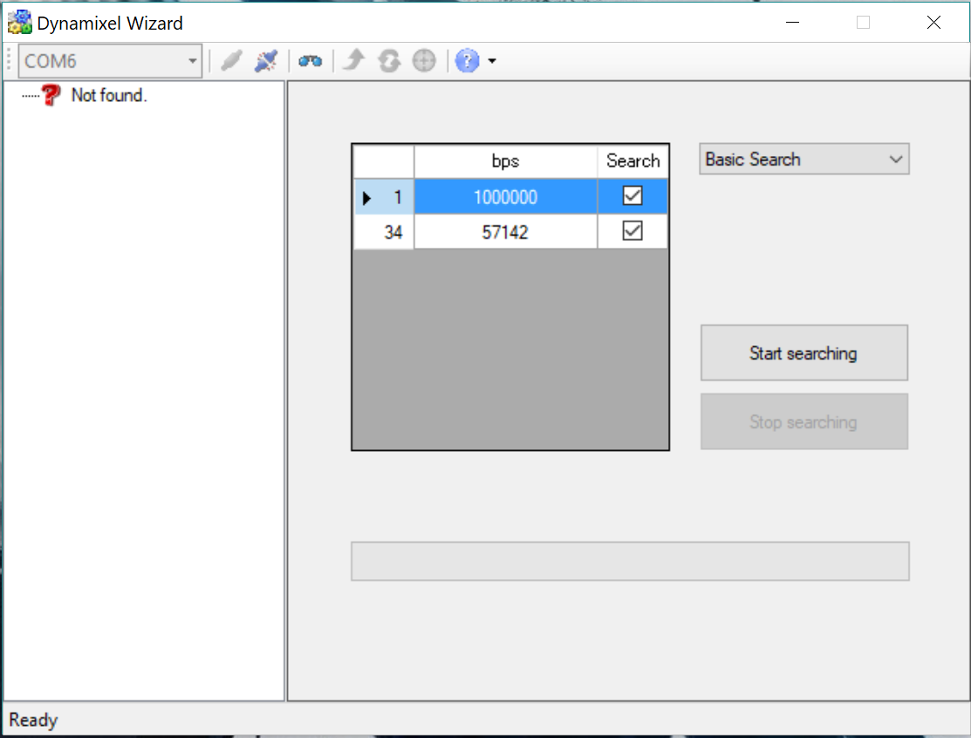
Dynamixel Wizard – Search Servos
Make use 1000000 bps is selected
Click on start search

Slide 15
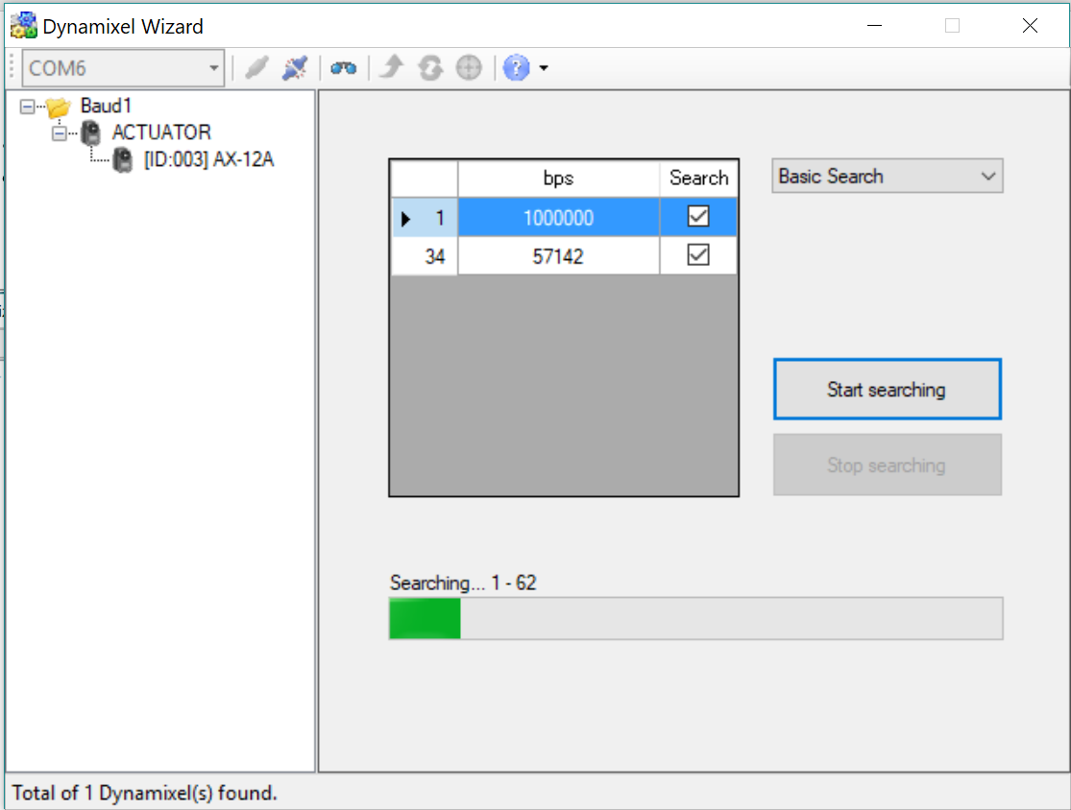
Dynamixel Wizard – Search Servos
The servo names and ID will appear here
Select the servo and double click on it.
You can click on stop when it finds the servos or wait until the search ends.
It will start searching for ID numbers

Slide 16
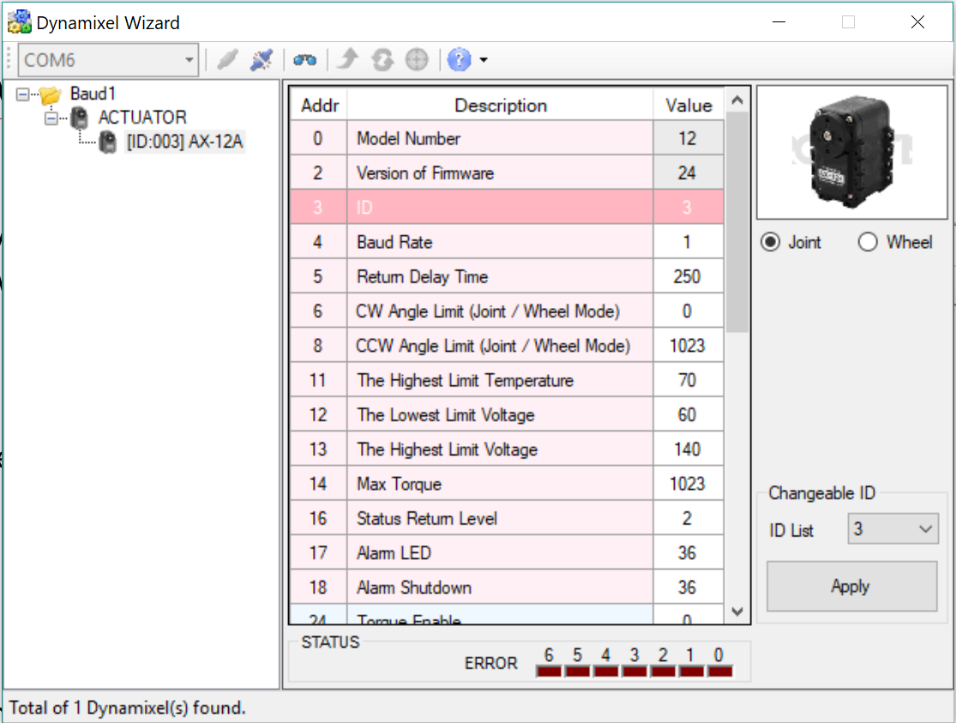
Dynamixel Wizard – Set ID numbers
Select the value you want to change
Change the ID number and click on apply

Slide 17
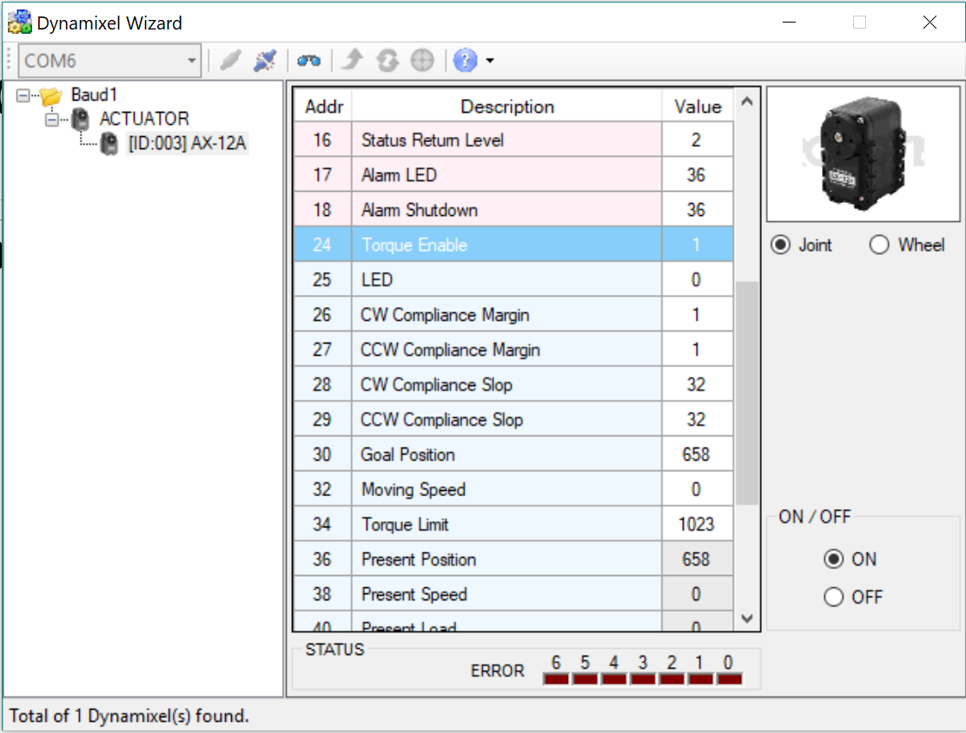
Dynamixel Wizard – Turn on/off a servo
Select torque enable to power on/off the servo
Select on to enable the servo

Slide 18
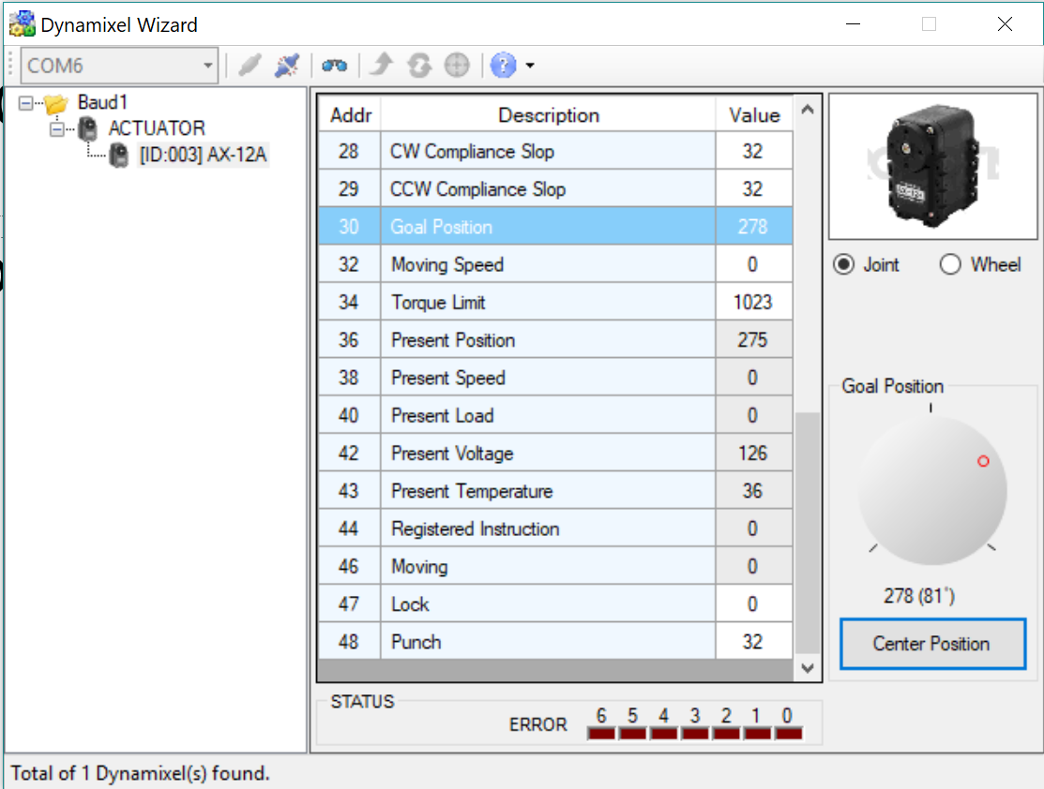
Dynamixel Wizard – Set goal position
For testing the servo select goal position
Move the red circle to move the servo.
Before put adding servo to the robot make sure it is in the center position!

